Slide 1
GLOBE, Asia – Pacific Regional Meeting
May 21-23, 2019
Seoul, Korea
Deborah Rebluud Nagata

Slide 2
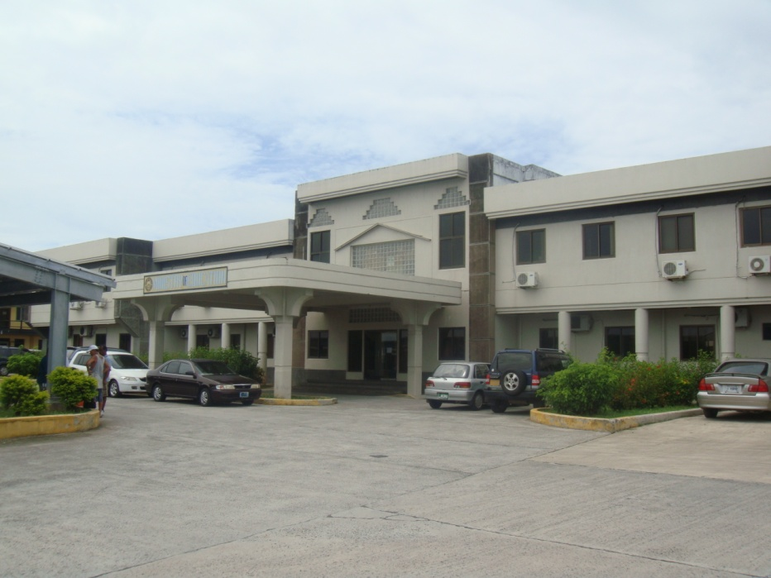
Presentation Outline
About Palau
Public Education System
Community Partnerships
Globe Related Activities
Division of Research and Evaluation, Ministry of Education

Slide 4
Agency and Community Partners:

Slide 5
About Palau
Capital: Melekeok
Land: 487 sq km
EEZ: 600,900 sq km
Population: 20,044 (2006 est.)
Language: Palauan, English
Currency: United States Dollar
Economy: Fisheries and Tourism
In 1946 Palau became one of the Trust Territories of the Pacific Islands under the governance of the USA. In 1994, Palau gained its independence and joined the United Nations as the 185th member.
Division of Research and Evaluation, Ministry of Education

Slide 6
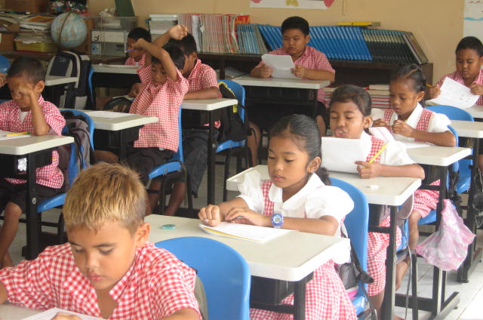
Education System
Ages 3-5 | Ages 6-17 |  | Ages 18 and Over
Pre-School | Elementary School Grades 1-8 | High School Grades 9-12 | College HiSET/Adult High School
The Ministry of Education is primarily responsible for service delivery in the elementary and high school levels (ages 6-17). However, it works in close partnership with pre-school service providers and the local college for delivery of educational services in the Republic of Palau.
Number of Public Schools:
 15 elementary schools
1 high school
1 community college
6 privete schools
Division of Research and Evaluation, Ministry of Education

Slide 7
GLOBE ACTIVITIES:
TRAININGS:
Globe & CMT-Mosquito Training – July 24-25, 2018 & July 11, 2018
January 26-29,2019 with Dr. Desh
Implementation of Environmental Science with Globe Project Protocol to Implement – August 2019
Earth and Water Day April 22-26, 2019
CMT Training with Public Health – May 4-5, 2019

Slide 8
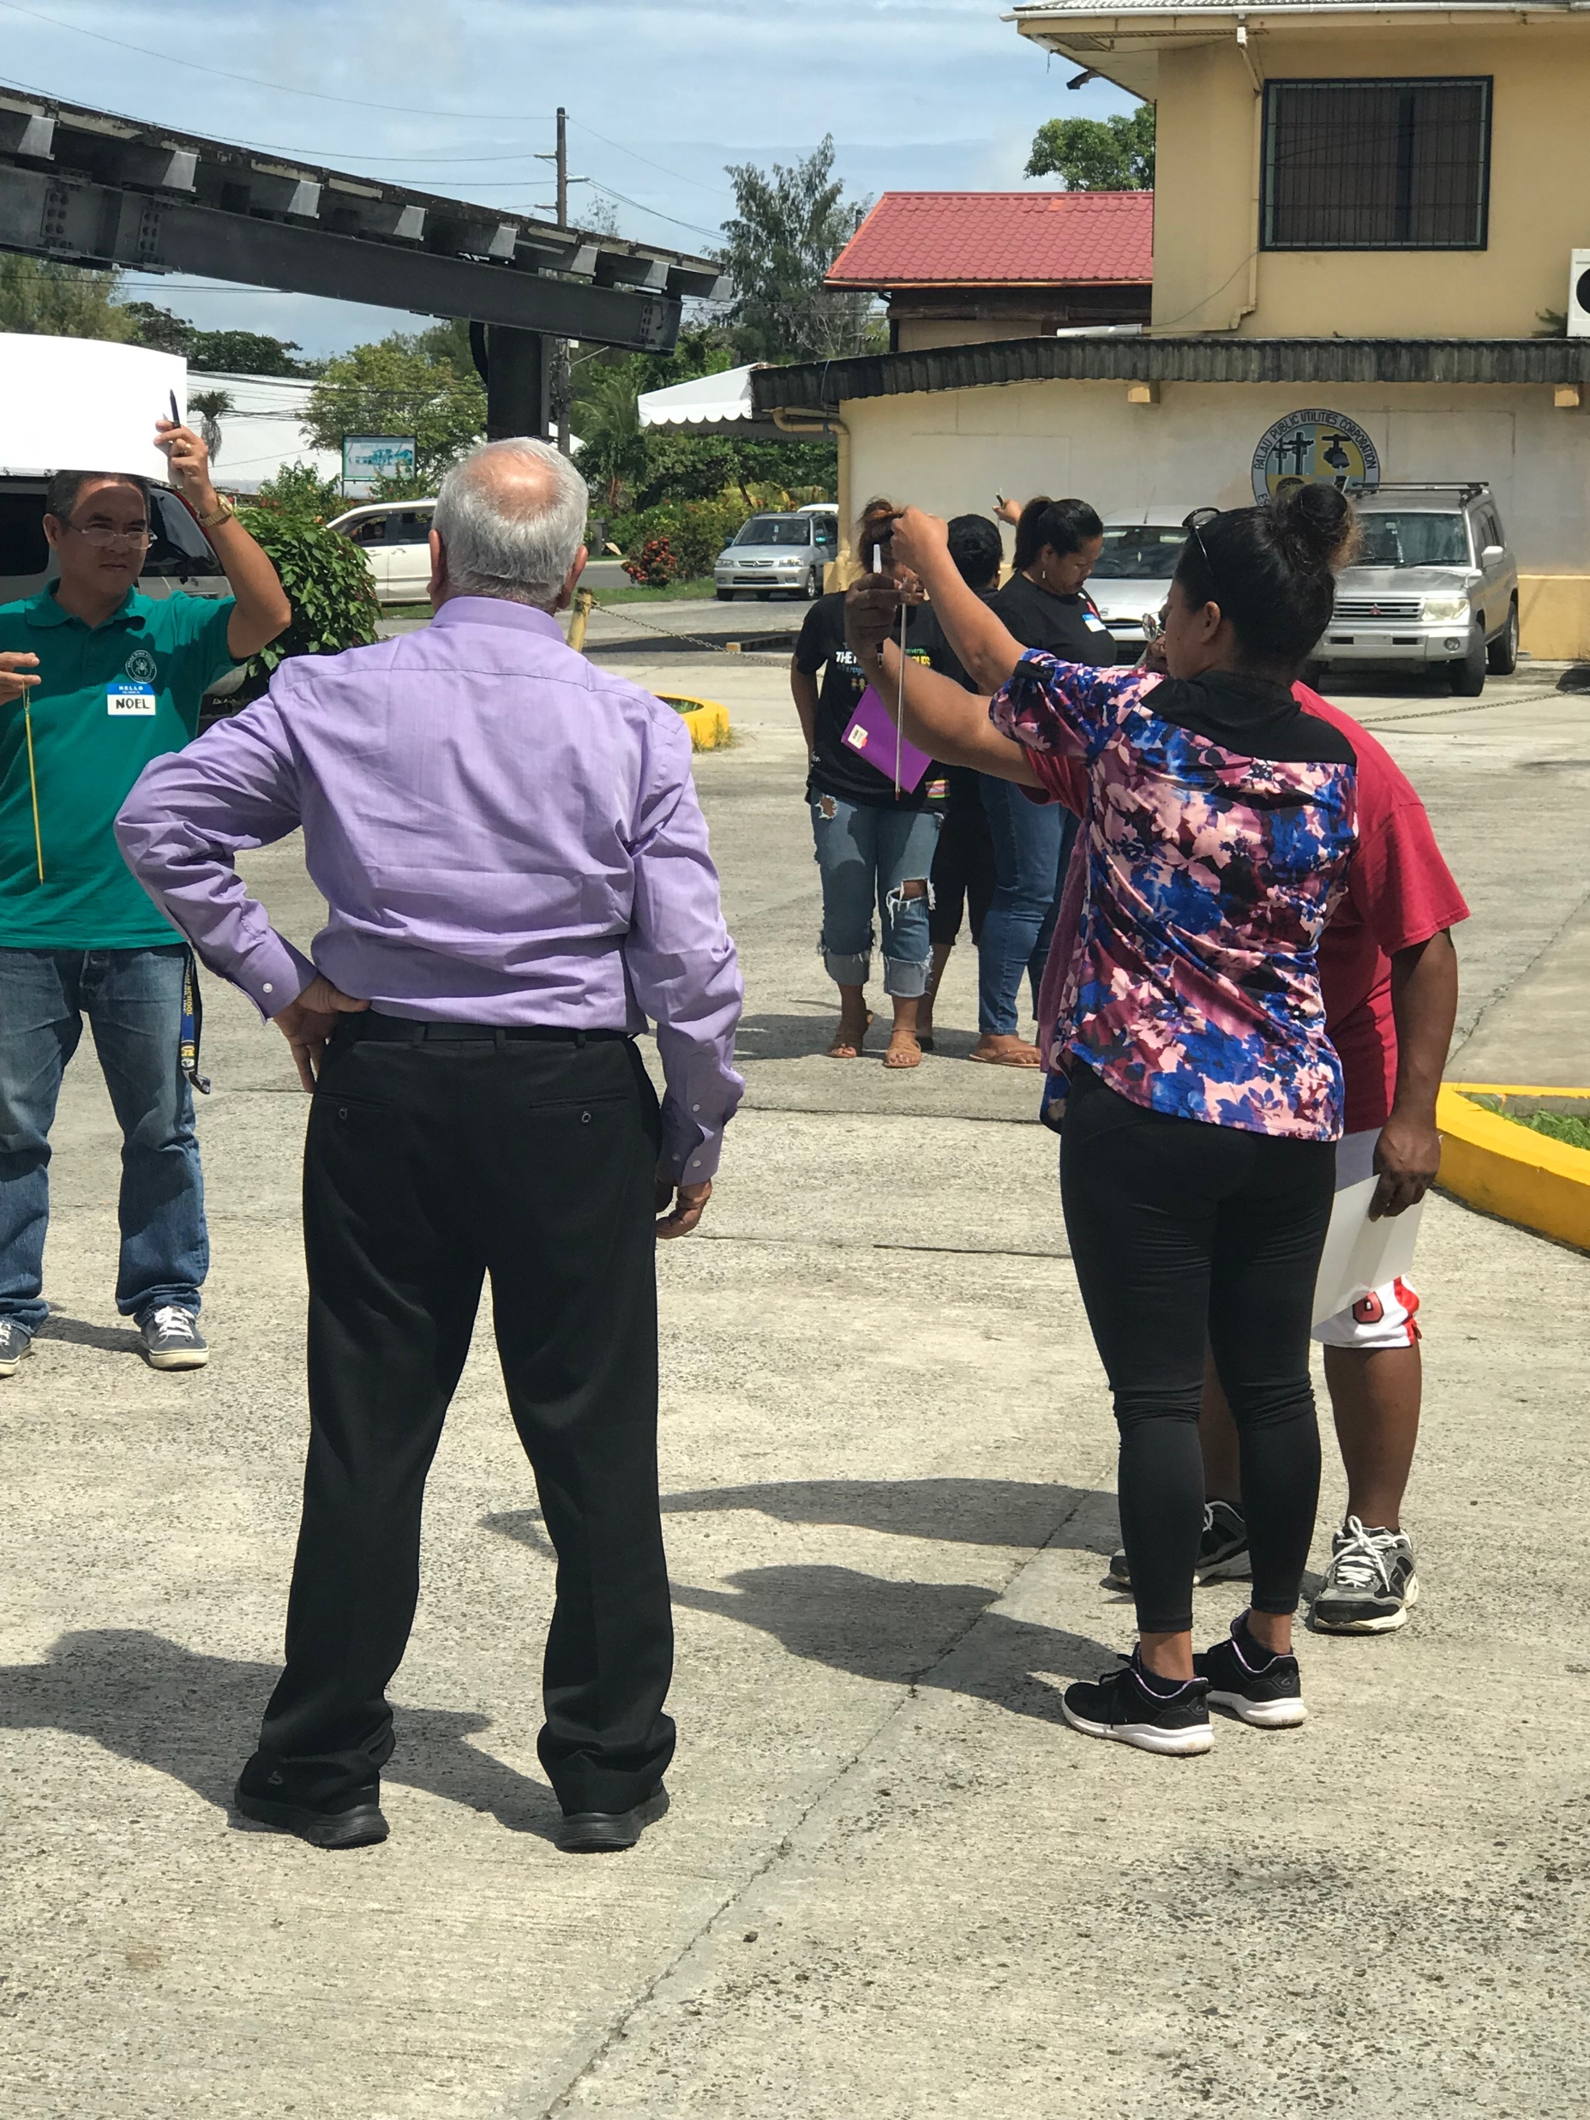
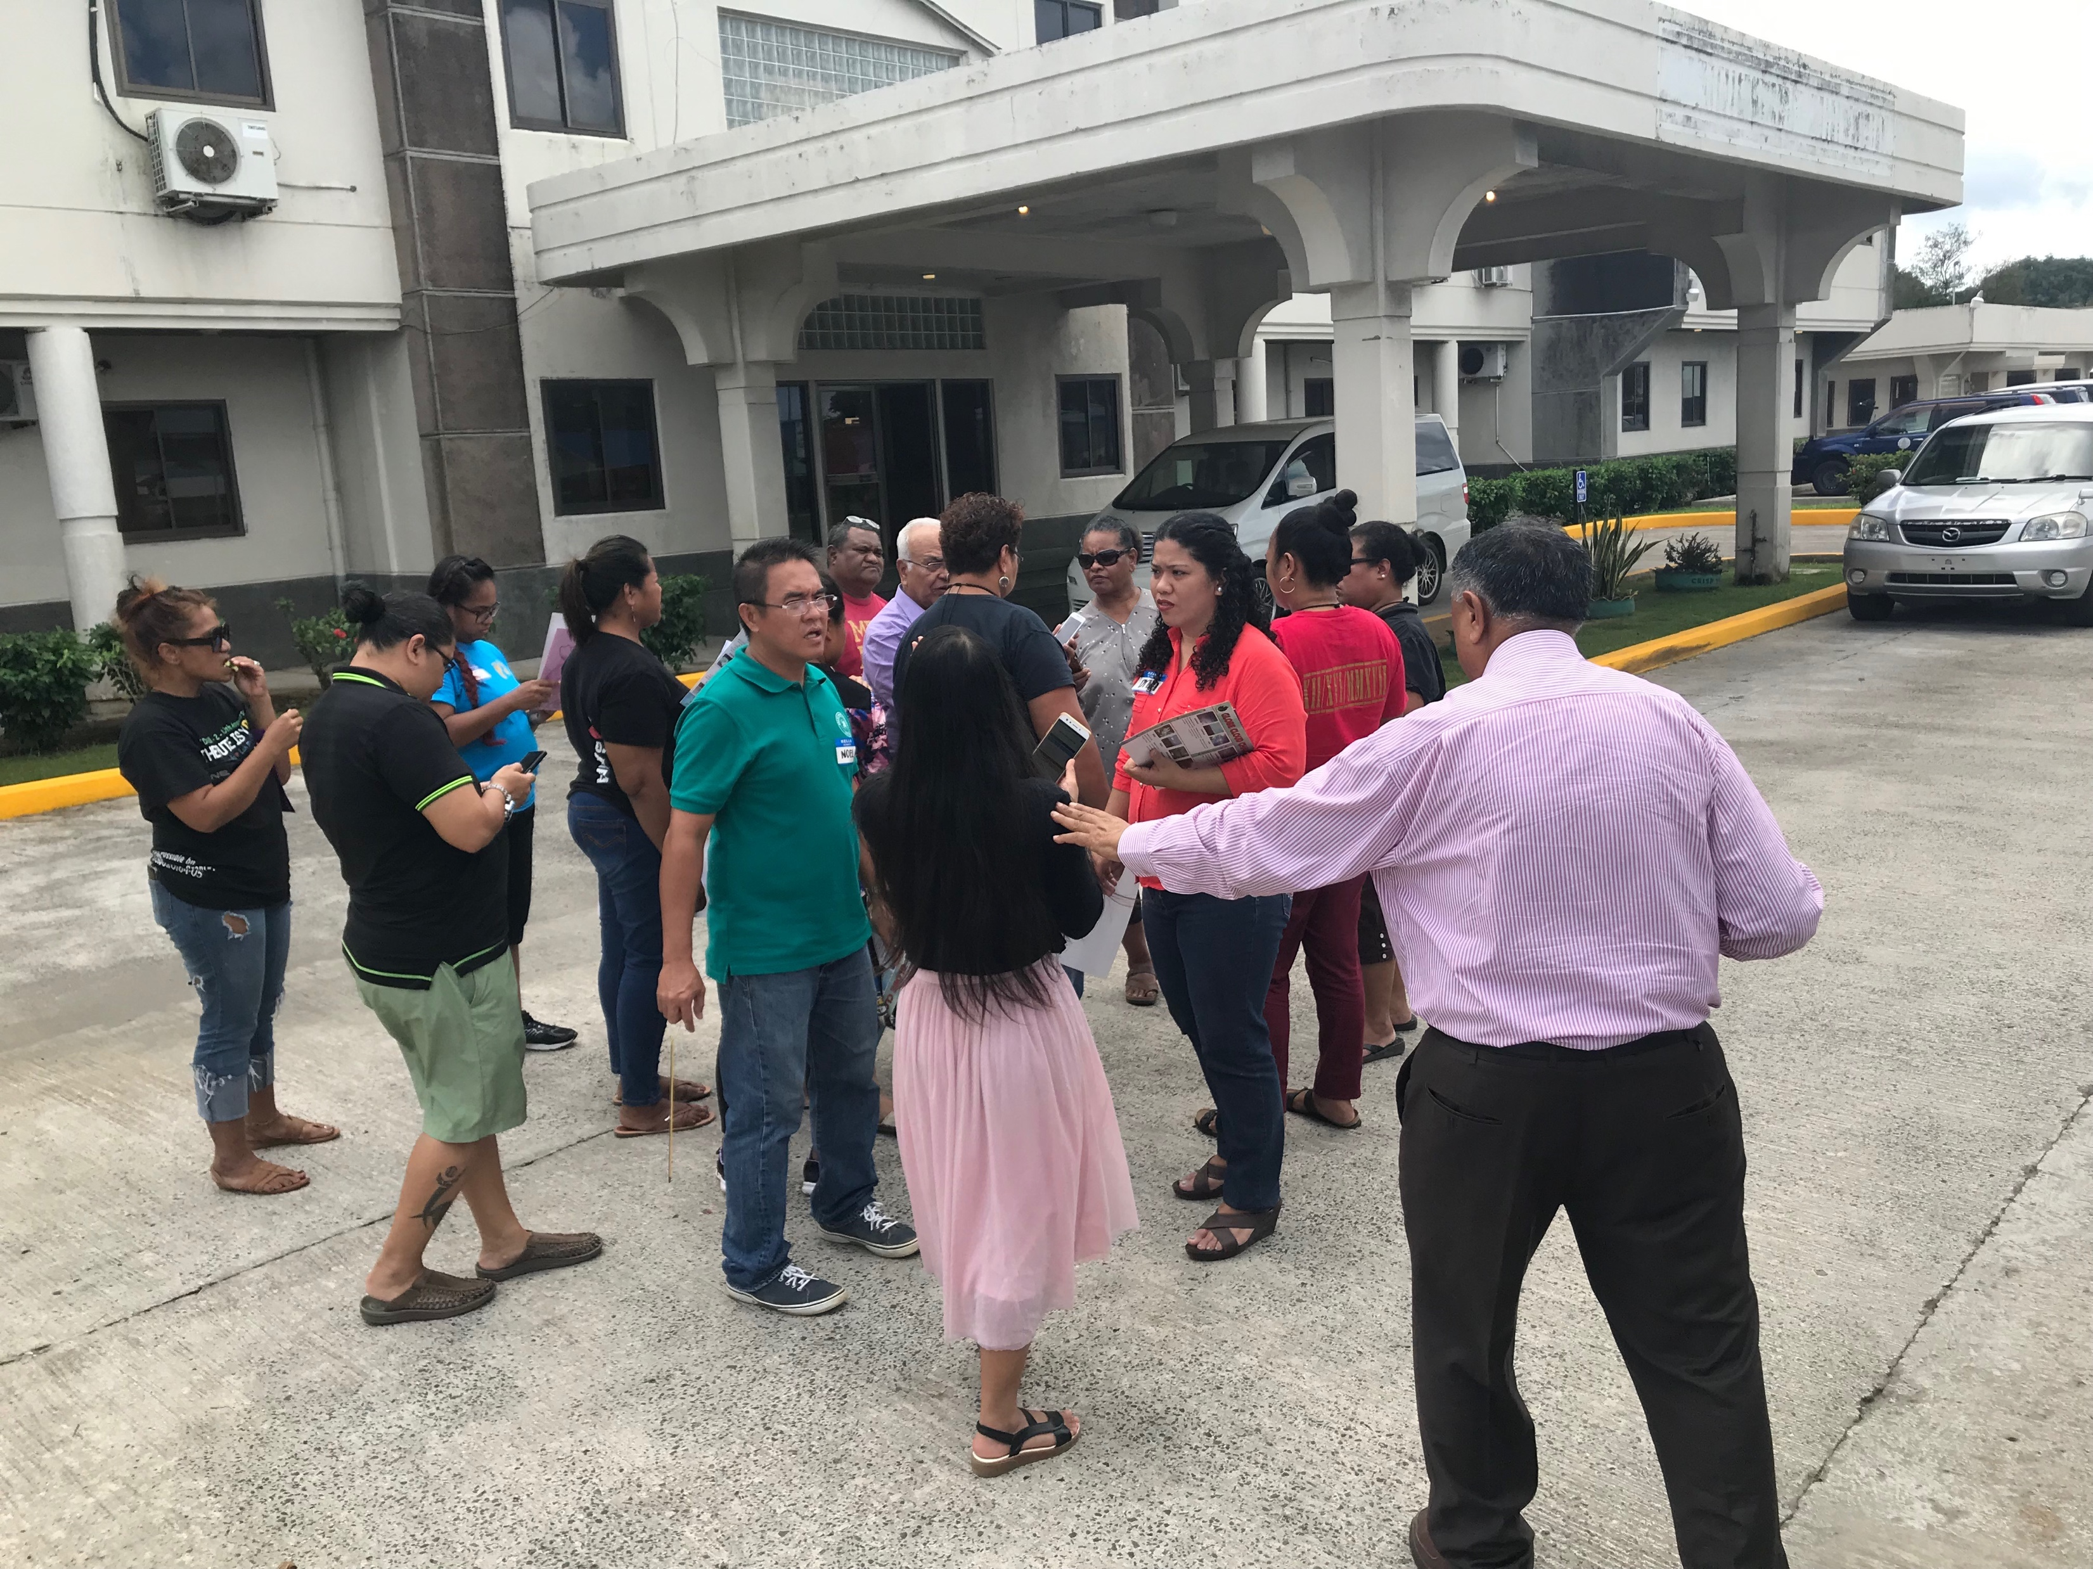
January 26-29, 2019, Globe and CMT
January 26-29, 2019
January 26-29, 2019

Slide 10
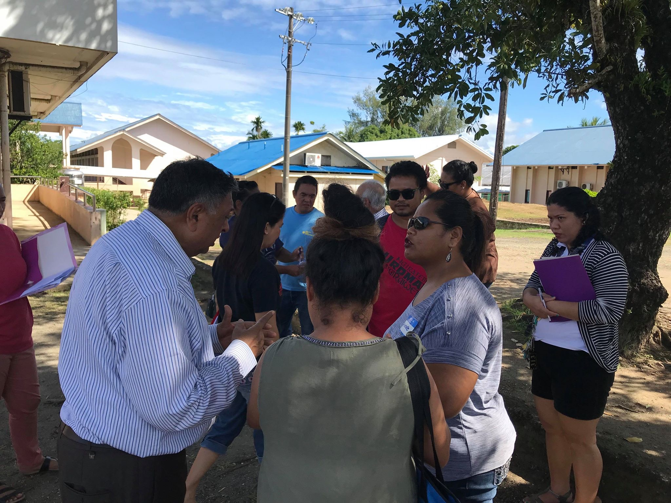

Slide 11
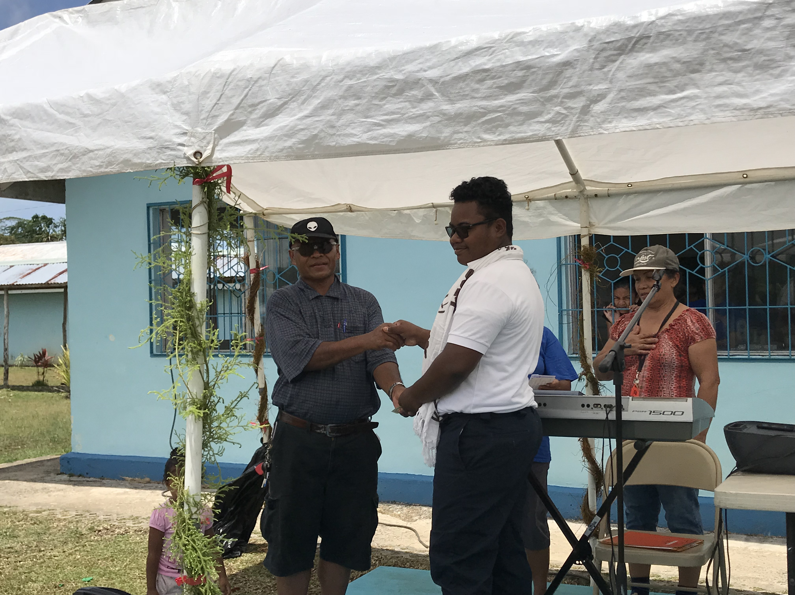
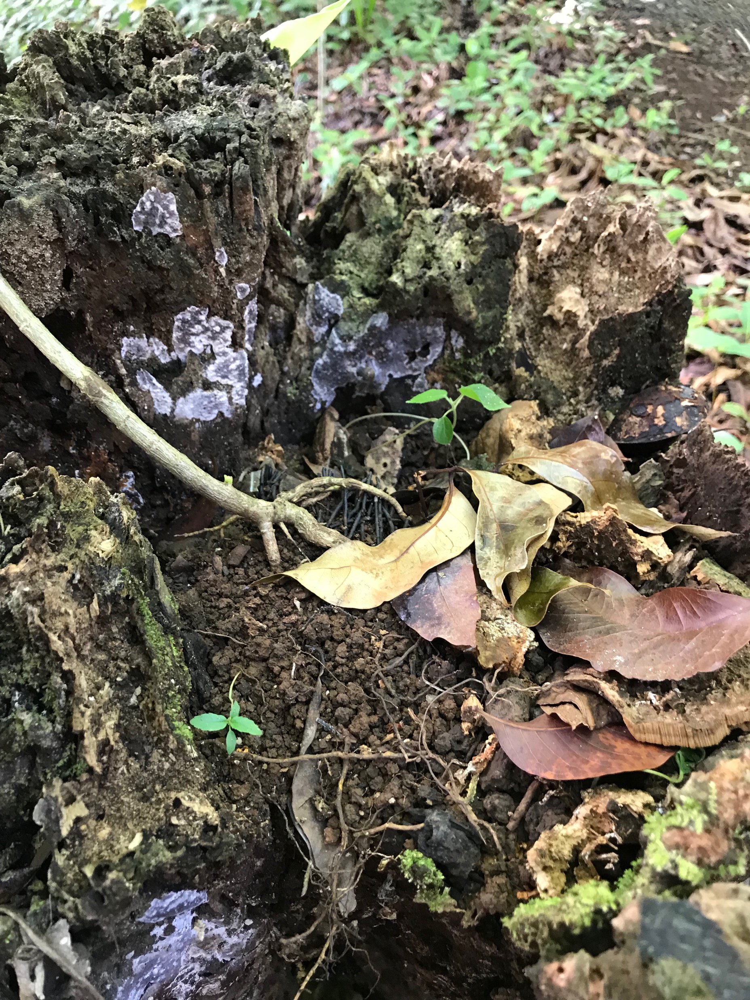
Earth and Water Day Activities, April 22-26

Slide 12
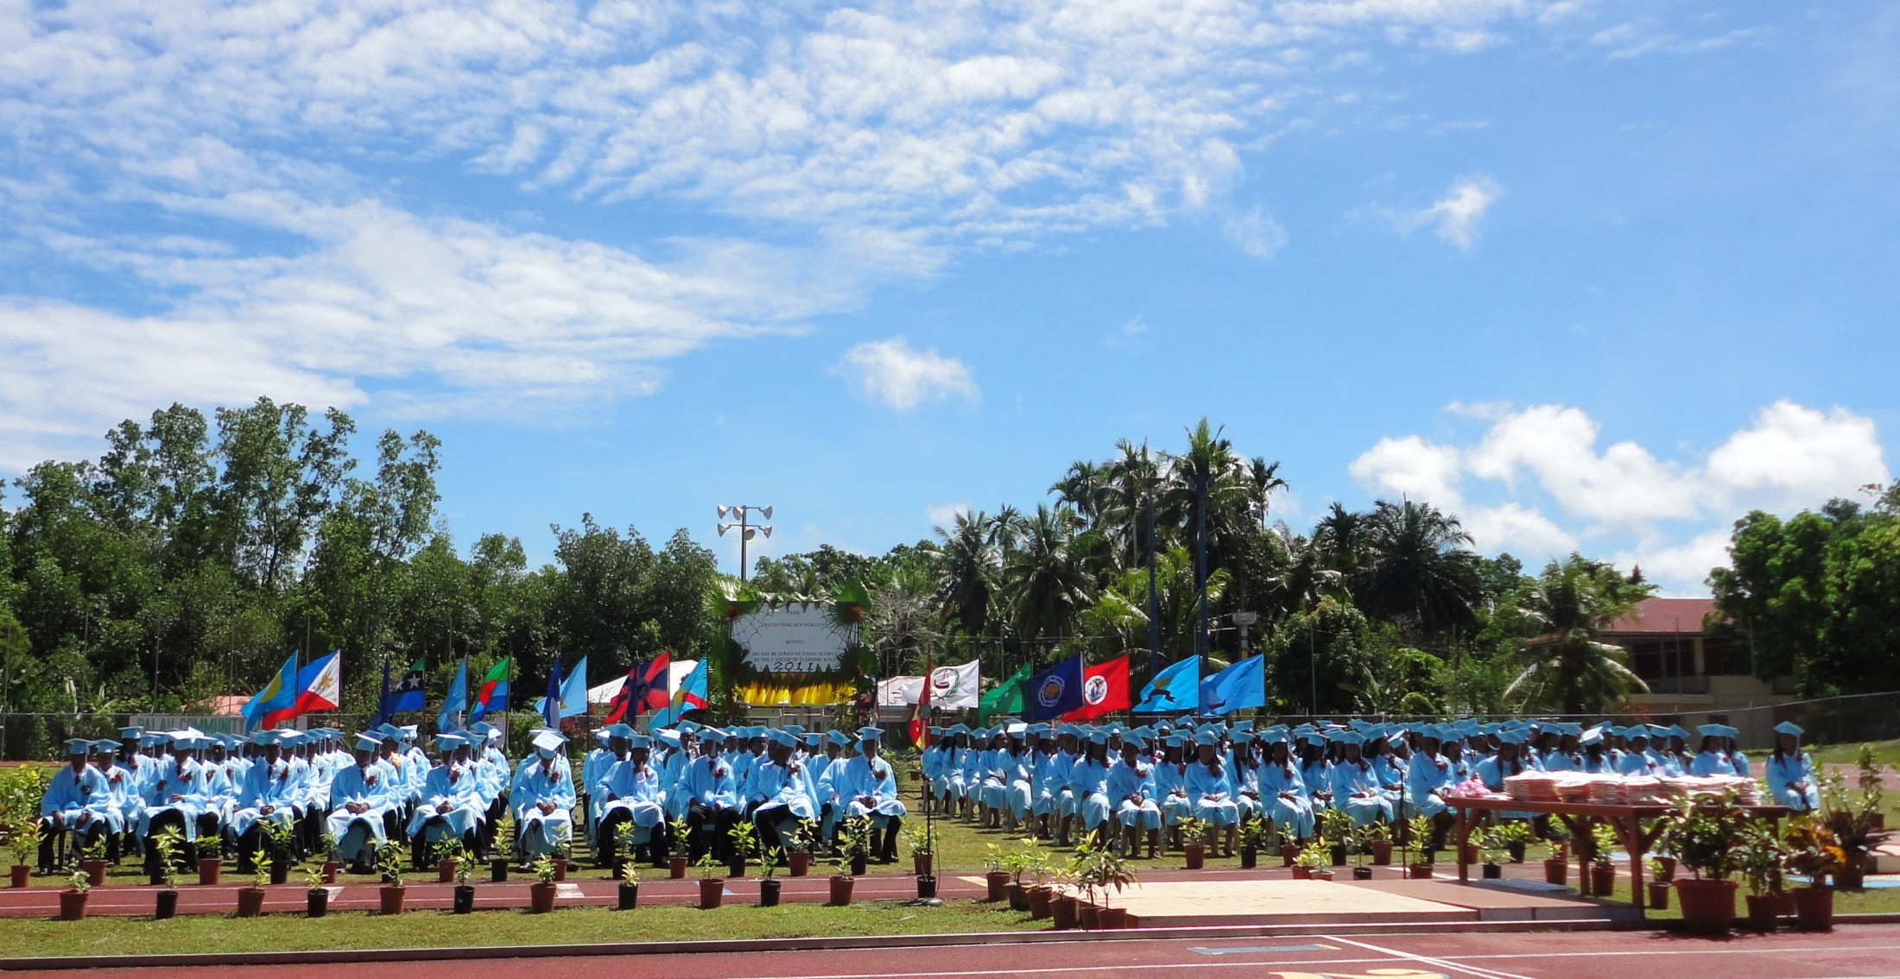
Thank You
Kom kmal mesulang
Division of Research and Evaluation, Ministry of Education

